Slide 1
Art and Thievery
Creating Verisimilitude
www.amylaurens.com

Slide 2
Perspectives
Everyone in the world is NOT like you
  Culture
  Age
  Education
  Interests
  Skills
  Abilities
  Expectations
  And lots, lots more.

Slide 3
Perspective Exercise
Perspective is about including the details that different kinds of people notice.
Imagine, in as much detail as you can, a room. It can be a real room, one you know well. That’s fine.
You have 90 seconds to write about this room, BUT you must write as though an axe murderer is chasing you and will burst through the door at any second.
Now you have 90 seconds to write about the room as though you were considering hanging a painting.

Slide 4
Thievery
You can’t experience perspectives other than your own.
Research!
  Read books about the kind of person you want to write about
  Read books BY the kind of person you want to write about
  Talk to people like the kind of person you want to write about

Slide 5
Character Match
PERSON 1 | Likes aquariums | Finds watching the fish relaxing | PERSON 3 | Likes shopping centres | Finds watching the people pass by relaxing
PERSON 2 | Likes aquariums | Enjoys meeting with friends in the cafe | PERSON 4 | Likes shopping centres | Enjoys shopping for clothes with friends

Slide 6
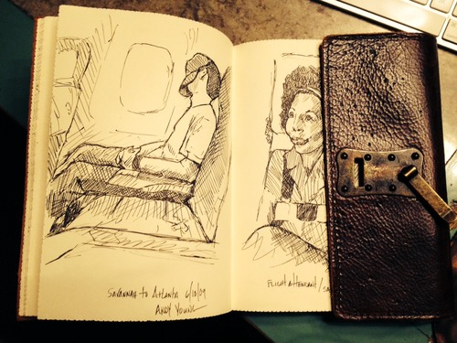
Art & Thievery – Maggie Stiefvater
Notes:
A few years ago, I began bringing a sketchbook with me as I toured. I wanted to get better at sketching people in real time, and the only way to get better in just about anything is practice.
Here’s the annoying thing about people who are alive, though, something you, too, may have noticed: they move. They move even more if they get wise to the notion that you’re sketching them. So by this point, I had begun to choose my victims rather carefully. People reading books. People staring at signs. People dozing on their hands. People studying their lunches with distrust. In this case, I was on an airplane, traveling from a tour stop to a tour stop. Normally I didn’t sketch on planes, because all you can see are the backs of people’s heads, or your seatmate, who can definitely spot that you’re sketching them, and will definitely move around, even if he or she is distrustful of his or her lunch.
Also normally I write on airplanes. I very much enjoy writing on planes, but only as long as I am in the window seat with only one flank to protect. This is because of a flight when I was trapped in a middle seat and after I wrote a joke into my novel, the man beside me laughed. I asked him: why did you DO that? And he said SORRY, it was funny. And I told him: YOU HAVE RUINED MY LIFE. From then on, I only wrote in window seats.
On this particular day, I was in an aisle seat, so there would be no writing. The seat in the middle was empty. In my coveted window seat was a young man whom I hated for being in the coveted window seat. Once I got over my resentment that he had stolen my throne, however, I realized that he was an ideal victim for sketching, as he was sitting with his ball cap pulled over his face. He was so still that it was possible he was dead. PERFECT. Dead people rarely move! I would check him for a pulse after I was done.
So I sketched him with delight, and then, a half hour later, I heard a voice. “Is that me?” He had this real soft Southern accent — the sort I’d grown up with back in the Shenandoah Valley — and it was audible because he’d removed his hat from his face and because he was alive. I showed him the drawing. He was pleased. I told him that I couldn’t write because I wasn’t in the window seat, and it was a long plane ride, so he might as well tell me his life story. It wasn’t long enough for his entire life story, but he did tell me how his hand. I had noticed it while I was sketching: it was oddly shaped, and I’d drawn it oddly shaped. When he noticed that I noticed, he told me the tale of how he’d broken it. It turned out that, although he assured me he was a peaceful creature, he’d broken it on someone’s face. He’d been in a minor altercation defending his sister’s honor. As he was telling me this story — which may or may not have been true — I was listening to him with my mind on record. I was getting ready to steal him.
I used to steal the surface of a thing. I would have stolen that story of the barfight, for instance, and all the details around it, wholecloth. I would have recorded it as truthfully as I could imagine and I would’ve been proud of myself for accurately transcribing the human experience. But that’s bad thievery. Shallow thievery. Copying, not artistry.
Now I know that when I’m stealing someone, it’s not their details I need. It’s their soul. I’ve learned to solve for x. To simplify to the essence. It’s not about the punch. It’s about why he threw that punch. No, it’s about why he threw that punch then and never any other time. It’s about how he’s telling me the story. How he includes his sister’s honor in this story of a single, crippling punch, because her honor adds a weight that the mere velocity of the swing does not. He can’t own that punch — that single punch — even to me, a stranger on a plane, without including the backstory of its purpose. It’s about how he wants me to know that he’s not bragging about a casual barroom brawl, this hand — this broken hand — he broke his hand for a reason.
Here’s the thing: he could’ve been lying to me. His story could be completely fabricated, and then, if I stole that story, I’d be telling a lie of a lie. A copy of a copy, each version a bit less like reality. That would be bad stealing on my part.
But here is solving for x, simplifying for the truth, stealing the essence. Here was the truth, sitting beside me, a confession in the knit of his eyebrows and that soft Southern accent. Here was a boy who had lost his temper once, much to his shame, and here was a boy who had had to look at that moment every day since it had happened. Everything else was details. Just noise. But THAT was the soul: and that’s what I stole.
That boy became Adam Parrish from the Raven Cycle.
A boy who made a mistake and has to live with it every day. A boy who carries physical evidence of a moment’s anger.
Writer? I am a thief and an artist.
Excerpted from http://maggie-stiefvater.tumblr.com/post/94588453381/artist-thief-an-excerpt-from-my-scbwi-keynote-for

Slide 7
Take-Home Point
Remember: WHY is more important than WHAT.

