Slide 1
Showing vs Telling
www.amylaurens.com

Slide 2
Some contrasting Examples from The Dream Thieves by Maggie Stiefvater
In an article on showing vs. telling, Stiefvater gives the following example. She could have introduced the three brothers like this:
Niall Lynch had three sons. The oldest, Declan, was a political creature, slimy and disingenuous. The youngest, Matthew, was incredibly delightful and everyone liked him without any effort on his part. And the sarcastic middle son, Ronan, was always belligerent. Their father was far more of an influence on all of them than their mother.
Instead, this is what she wrote:

Slide 3
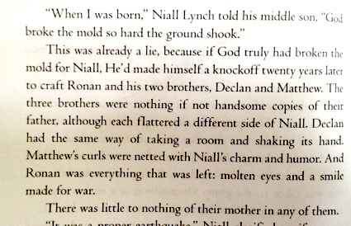

Slide 4
Another Stiefvater example
This time, she discusses a particular party scene in the novel:
Oh, I had such plans for this party scene. I wanted the reader to see it just like I did. The all-encompassing luxury, warm and old and unquestioned. The complexity of the political world, the beauty of wealth, and the stagnation and corruption of old, unchallenged value systems. Adam, as my point-of-view character, is feeling and thinking about all of these things, and I wanted the reader to experience it with him.
I could have told the reader all of those things. Point blank. I could have gone with a barebones description of the driveway:
The circular driveway was packed with so many elegant vehicles that the valets had to turn cars away.
And then just had Adam muse in italics about his feelings on being there.
Instead, she wrote:

Slide 5
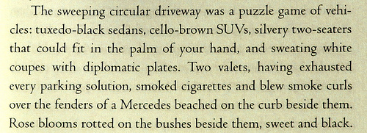

Slide 6
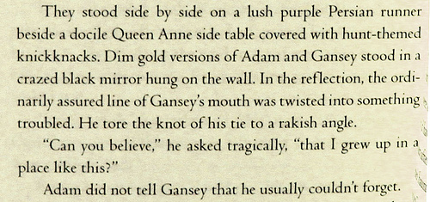
A third example

Slide 7
Stiefvater says:
Man, I was working hard in this little section. In reality, the hallway of the house is lush and content and established. But inside our two protagonists, trouble brews — you can see it in the mirror. The side table, on the outside of the glass, is docile. But the mirror-image of the tidy hallway is crazed and twisted and rakish.
Again, I could’ve just told you: on the outside, the boys look foxy and orderly in suits, but on the inside, they are hot messes.
But I don’t want you to know. I want you to feel.

Slide 8
Your Turn
For each of the following activities, we will set a timer for 5 minutes and write without stopping. Your goal is to include the information given without ever stating it directly.

Slide 9
Exercise #1
Your main character has just seen somebody important (a politician or celebrity) die. They are alone in their kitchen, when a family member walks in. Write the conversation that ensues.

Slide 10
Exercise #2
Your main character is in their bedroom, doing their homework. Without ever stating it outright, convey to your reader the fact that your main character is a mouse.

Slide 11
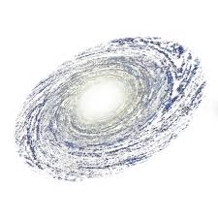
Exercise #3
Your character has just arrived in town after travelling for five years across the galaxy. They are tired and very hungry, but all the food looks different to what they are used to and they are not sure the place they have arrived in is safe.

Slide 12
Exercise #4
Your character is sitting next to someone in Maths class. They have a huge crush on this someone. The teacher pairs them up to work together for the lesson. Write what happens – and remember not to tell the reader directly that your character has a crush on the other person!

Slide 13
Exercise #5
It’s period 6 and your character has to demonstrate a complex magical spell they’ve spent the last six weeks practising in order to pass the class. Last lesson, their best friend betrayed them by telling the whole class an incredibly personal secret.

